Slide 1

TEAM 2 – TO SCHOOL
AJAY MUTHKRISHNAN
ANILRAJ PAZHETY
MIHIR GADA

Slide 2

Target Approach
Exploratory
Modeling
Recommendation
Within reach of all candidates
Eligible
Maximize Acceptance ratio
Maximize colleges approached
Optimize recruiters effort
Willing
Optimal # of clusters
Appropriate classification

Slide 3
Understanding the data
30% applications of 2016 came through in the last deadline.
Corresponding deadline missing for 2017
Q/Q trend from 2016 replicated on 2017 data
Extrapolation

Slide 4
Parameters used for assessment
TFA Awareness
Alumni, CM and Staff (acs)
Awareness Level
Potential Candidates
Accepted in ‘17 ; ‘16
Sourced
Met
Parameters to measure potential successful candidates are based on correlation data with past success parameters

Slide 5
Where the 3-tier system fails?
 | Awareness |  |  | Potential
Tier New | Total alumni (#) | Education Inequality Awareness | TFA awareness | Accepted (#) | Met (#) | Sourced (#) | Ratings | 2017 Application Count
Existing Tier 1 | 126.96 | 2.35 | 2.15 | 20.40 | 22.68 | 29.75 | 4.51 | 62.74
Tier 1- Misclassified | 15.39 | 2.27 | 2.18 | 3.09 | 5.00 | 5.73 | 3.88 | 13.91
Existing Tier 2 | 59.25 | 1.27 | 1.41 | 8.08 | 10.65 | 15.70 | 4.06 | 35.42
Tier 2- Misclassified | 24.81 | 1.04 | 1.36 | 3.62 | 4.89 | 7.28 | 3.91 | 16.55
Existing Tier 3 | 38.14 | 0.14 | 0.29 | 6.14 | 9.29 | 13.00 | 3.86 | 34.29
Tier 3- Misclassified | 13.39 | 0.44 | 0.30 | 2.07 | 2.80 | 3.41 | 3.48 | 11.15
New Tier 4
Tier 1
15% Misclassified
Tier 2
Possible Tier 4?
45% Misclassified
Tier 3

Slide 6
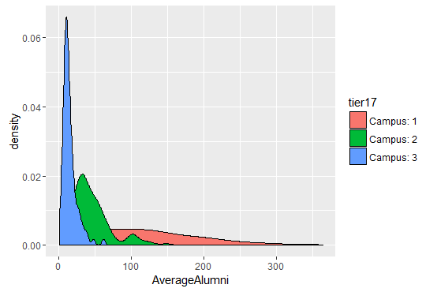
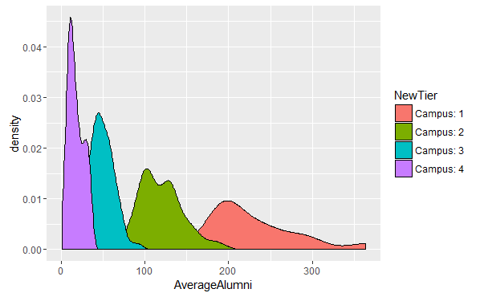
Success directly corresponds to effort
3 TIER SYSTEM
4 TIER SYSTEM
BEFORE
Success in existing tier system comes from tier 2 and tier 3 colleges where each individual handles less than 3 colleges
FOCUSED ATTENTION PAYS OFF
RECOMMENDED
The new system recommends having less than 3 universities per person.
 | Awareness | Potential | Universities/Person
Tier 1 | High | Medium | 1
Tier 2 | Medium | Low | 3-7
Tier 3 | Low | Low | 7-15
 | Awareness | Potential | Universities/Person
Tier 1 | High | High | 1
Tier 2 | High | Medium | 1-2
Tier 3 | Low | Medium | 2-3
Tier 4 | Low | Low | 3

Slide 7
Need for another tier?
Despite the difference in awareness, tier 2 and 3 have a marginal difference in performance.
The 4 tier new system clearly distinguishes across all 5 key parameters.

Slide 8
Benefits
Improved granularity of tier classification
Better monitoring of tier wise potential & performance
Future re-classification – easier with improved control
Improved definition of recruitment activities with tiers

Slide 9
Thank you!

